Slide 1
Data Ingestion and Store In Hdfs and Hive Integration
Name : Manan Gupta
Batch : me-30

Slide 2

Introduction
This project, "Dynamic Data Ingestion and Storage in HDFS with Automated Hive Integration," focuses on collecting data from the web, storing it in Hadoop's HDFS, and organizing it in Apache Hive for easy analysis.
Using tools like Python, Shell scripting, Hive, Hadoop and Linux, the project automates the process of fetching, storing, and visualizing data. The goal is to make managing large amounts of data easier and more efficient, ensuring that the data is stored securely and can be quickly accessed for analysis.

Slide 3
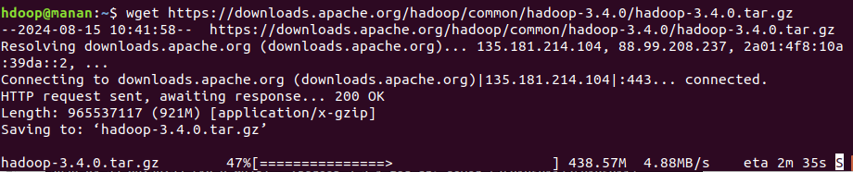
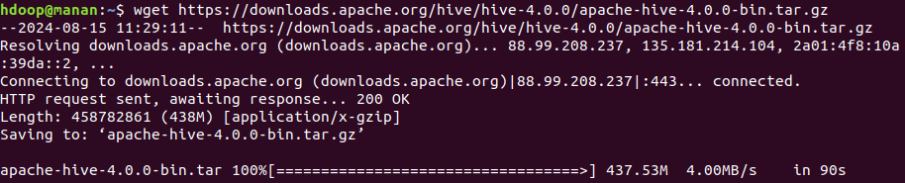
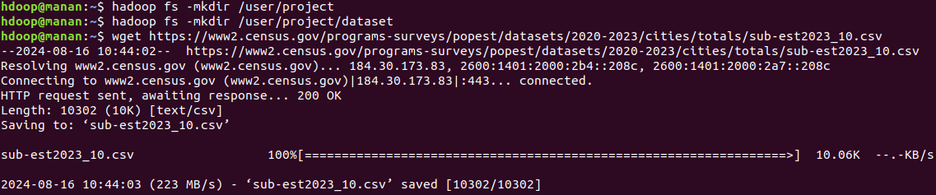
Data Fetching
1) Install Hadoop and Hive in my system.
2) Create directory to store the project data files.
3) Using `wget` I fetch data from the specified URL.

Slide 4
Data Storage
1) First, I downloaded data into local path.
2) Next, I used hadoop fs –put command to insert data in HDFS.
3) Then, I mentioned local path and HDFS path in command.
4) Finally, I used hadoop fs –ls to see file.

Slide 5
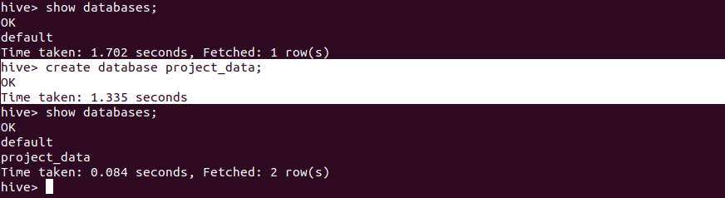
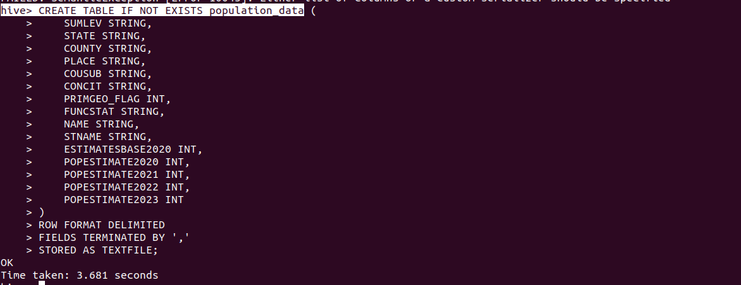
Hive Integration
1) In the Hive, I created database and table.
2) Next, I mentioned datatype and column name.
3) Finally, I mentioned format, Field and storage type. Then I created table.

Slide 6
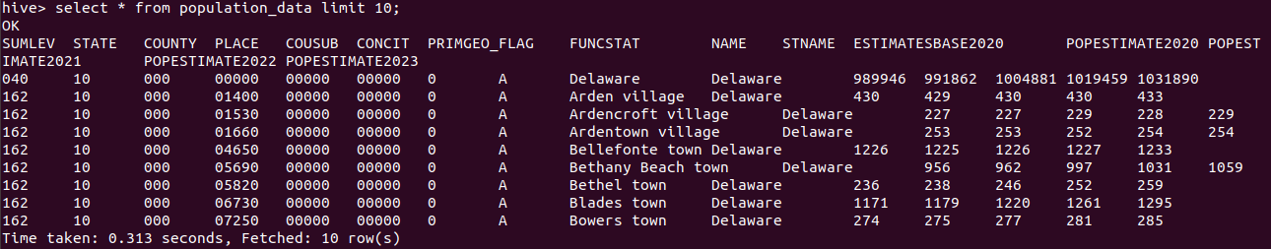
Hive Integration Continue…
1) Load data in the table
2) Used, select query to display data.

Slide 7
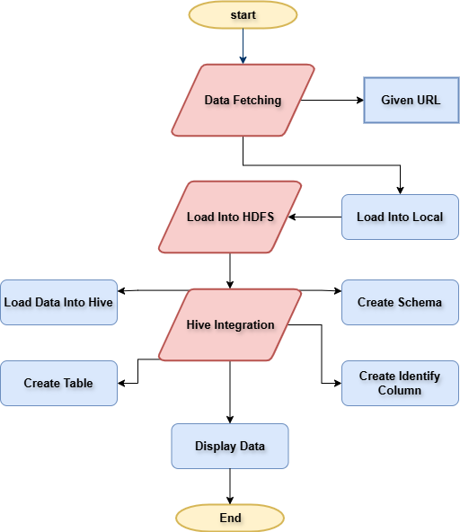
Workflow

Slide 8
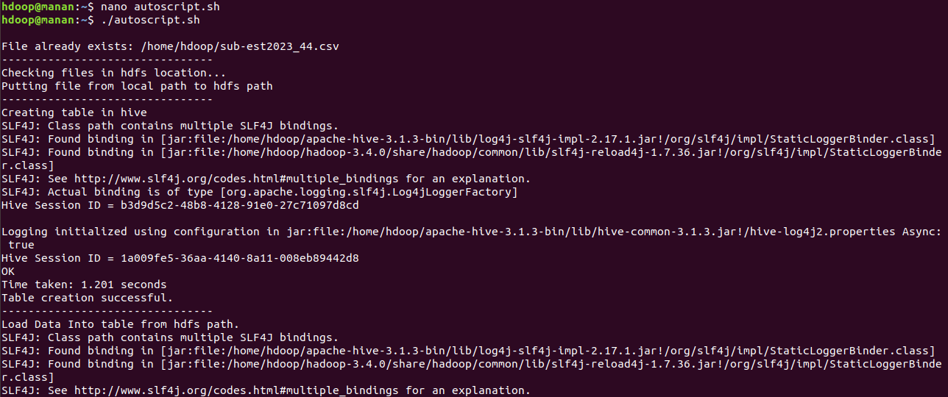
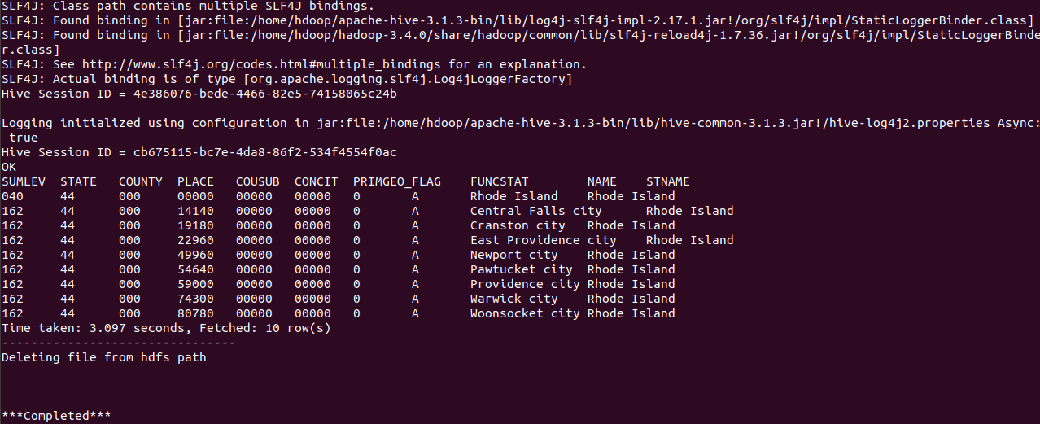
Auto script
1) Create Shell Script

Slide 9

Thank You

